Slide 1

Good Morning dear innocent kids
Notes:
Welcome slide.

Slide 2

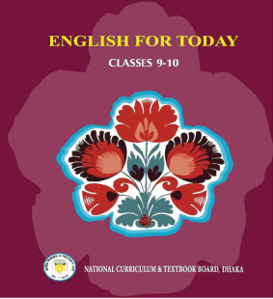
Introduction
Md. Hasan Hafizur Rahman
Lecturer (English)
Cambrian School & College
Building-5, Baridhara, Dhaka
Mobile : 01556652300
Class-IX-X
Subject :
English 1st Paper

Slide 3
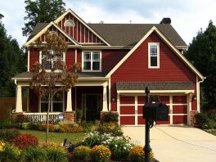
Grandfather built this house.
My father inherited it later.
Now I am living here.
It is my heritage. I won it from my father and I will pass it to my future generation.
Notes:
Suspension to advance the lesson.

Slide 4
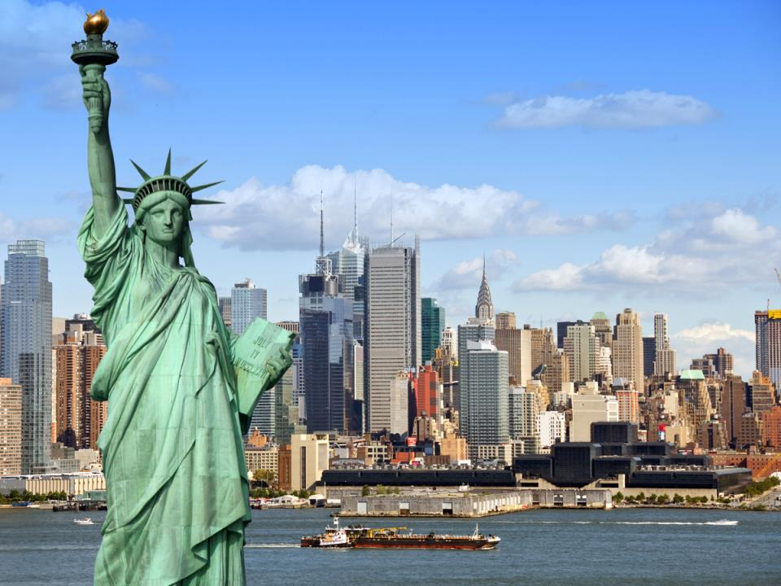
The Statue of Liberty
This is a world heritage.
Notes:
An example of world heritage.

Slide 5
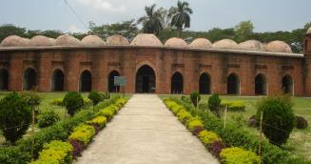
But
What is this?
Shat Gambuj Mosque
A world Heritage
Let’s have a tour.
Notes:
Advance to the lesson declaration.

Slide 6
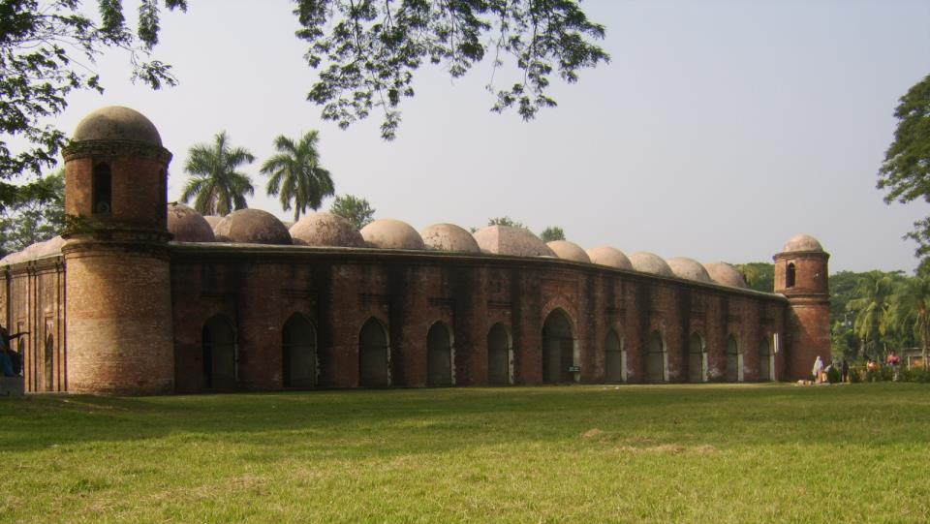
Can you tell me what is our today’s topic?
Unit-8
Lesson-1
The Shat Gambuj Mosque (A world heritage)
Notes:
Lesson declaration.

Slide 7
Learning outcomes
After we have studied this lesson , we will be able to---
ask and answer questions
understand through silent reading
describe a place
Notes:
Both the four skills will be achieved from this lesson.

Slide 8
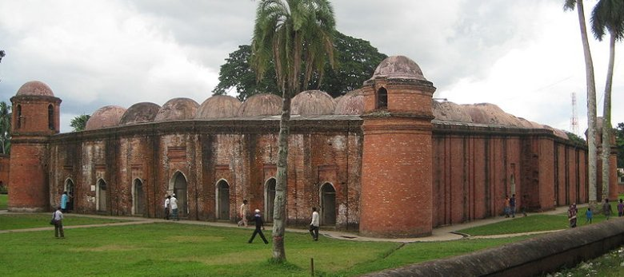
A. look at the picture. Work in pair Talk about the picture and ask and answer the following questions with your partner.
What is this building?
Do you have a building like this in your town/village?
3. What do we call it?
4. What is it for?

Slide 9
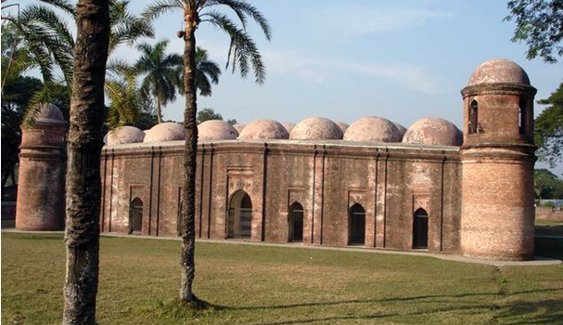
Let us introduce with some new words/key words.
Unique
Meaning : Exclusive/exceptional/distinctive
Shat Gambuj Mosque is a unique world heritage.
Notes:
If you have enough time, you can show this option.

Slide 10
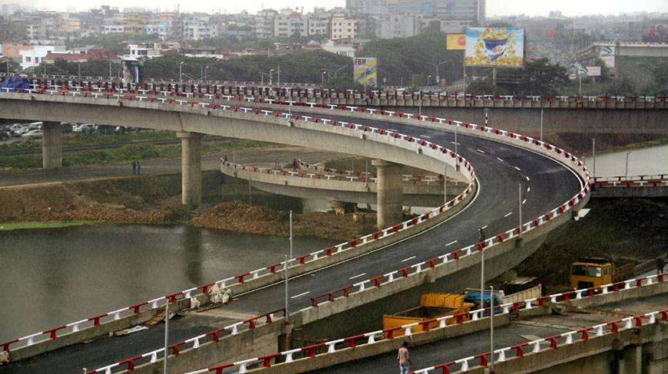
Outskirts
Meaning : Borders/outer edge/environs
Kuril is the outskirt of Dhaka city.

Slide 11

Mangrove
Meaning : Coastal tree/tree grows on river bank
Sunderban is one of the biggest mangrove forests.

Slide 12
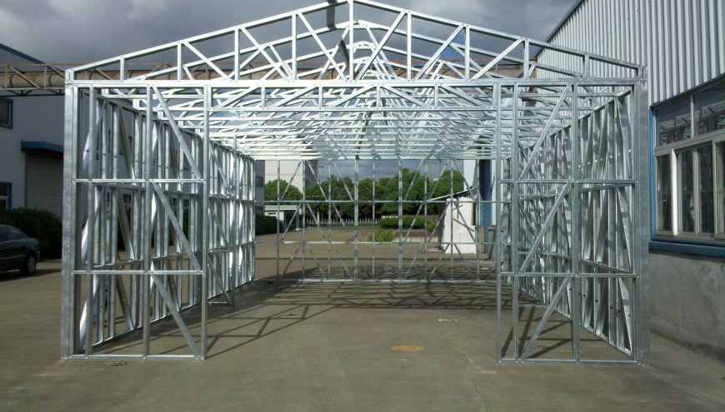
Infrastructure
Meaning : Frame/setup/structure/substructure
The infrastructure of this house is very strong.

Slide 13
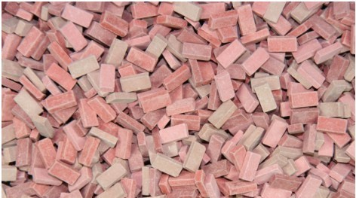
Baked brick
Meaning : Hard/ burned/ strong
Shat Gambuj mosque was built with baked brick.

Slide 14
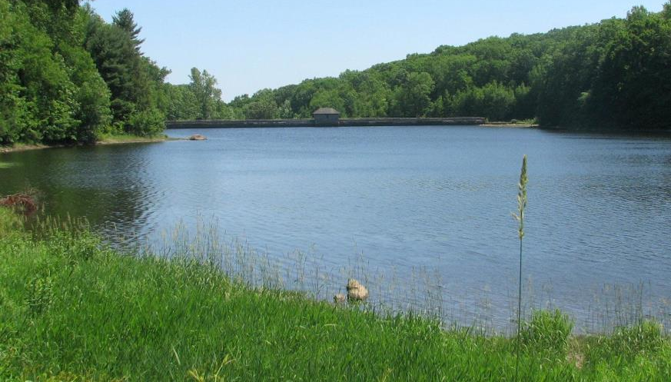
Reservoirs
Meaning : Tanks/pool/lake/pond
Khanjahan Ali made many reservoirs for people.

Slide 15
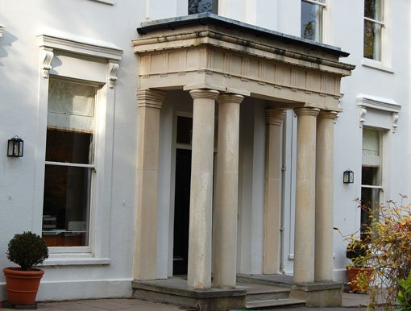
Slender stone column
Meaning : slim/handsome/trim
The building is made with slender stone columns.

Slide 16
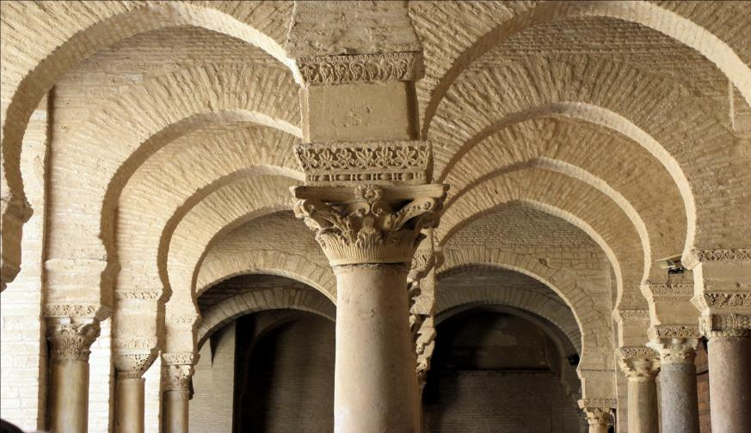
Arches
Meaning : curve/semicircle
There are 11 arched doors in Shat Gambuj mosques.

Slide 17
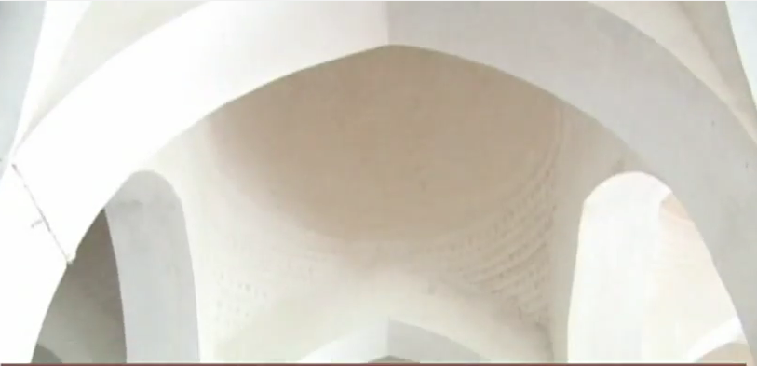
Hollow
Meaning : Empty space inside
Hollow
The interior part of every is a big hollow.

Slide 18
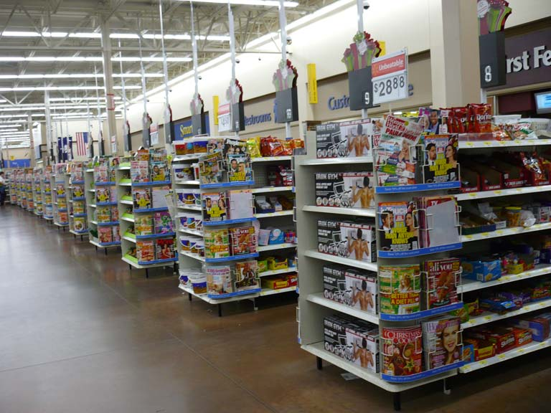
Aisle
Meaning : Narrow way
There are different aisles in this market.

Slide 19
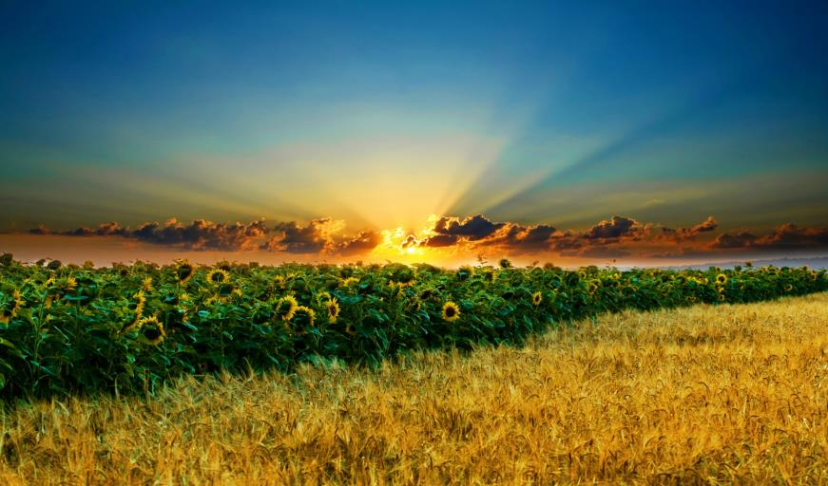
Remarkable
Meaning : Extraordinary/amazing/notable
The scenery is really remarkable.
Notes:
Word meaning.

Slide 20
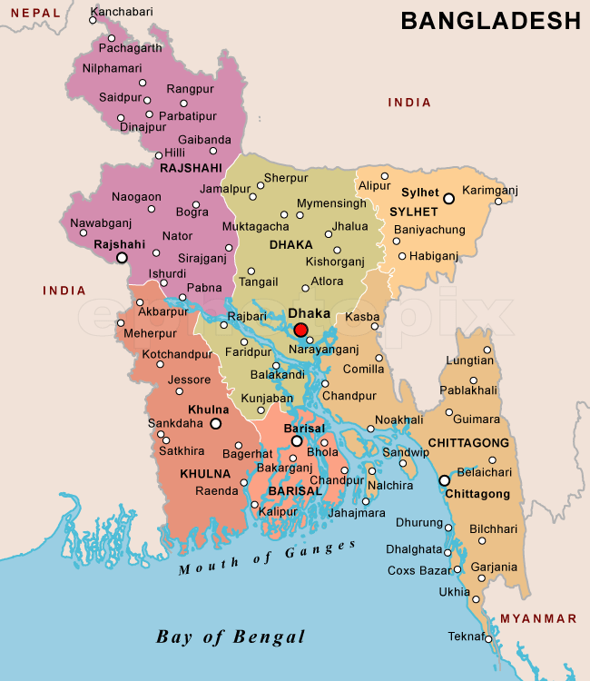
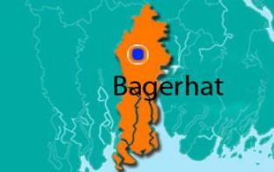
Why is Bagerhat famous for?
It is famous for Shat Gambuj Mosque.
Notes:
About Bagerhat.

Slide 21
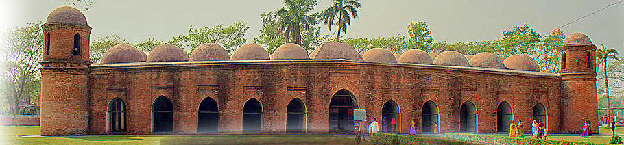
Smaller domes in 4 corners
77 low height domes
1
2
3
4
5
6
7
8
9
1o
11
11 Arched doorways on east
Notes:
In the eastern side of the mosque 11 arched doors are shown.

Slide 22
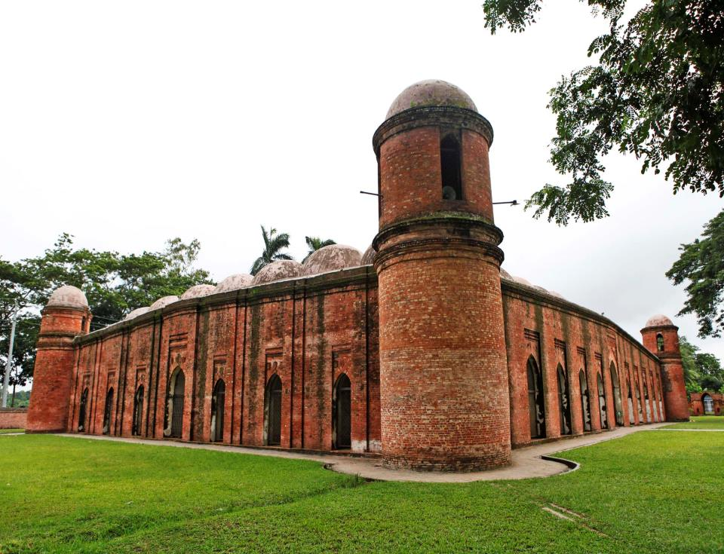
East of the mosque
South of the mosque
7 Arched doors in both south & north
Notes:
Location of 7 arched doors.

Slide 23
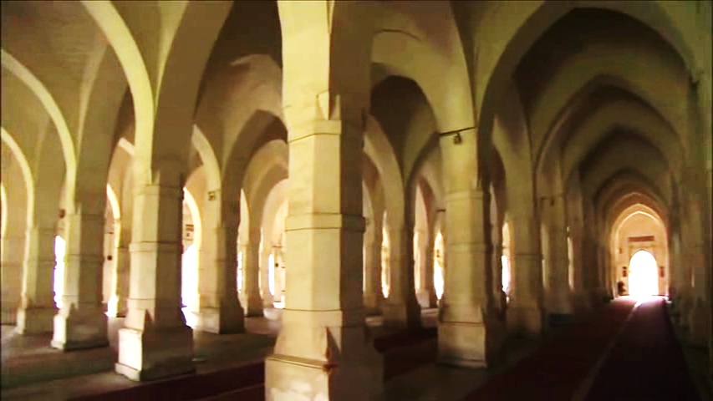
Inside the mosque
Notes:
How the inner side of the mosque built.

Slide 24
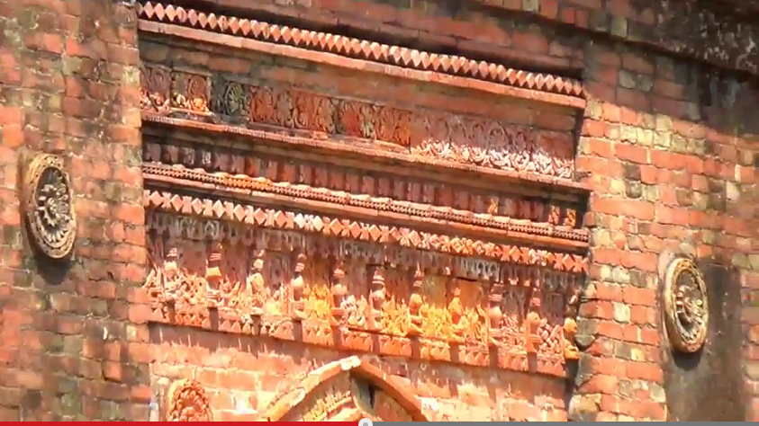
The interior western wall of the mosque is beautifully decorated with terracotta .
Notes:
A description shown here.

Slide 25
B Read the text and complete the chart.
‘Heritage’ is what we inherit from the past, live with them in the present and then pass on to our children or future generation. Our unique source of life and inspiration is our cultural and natural heritage. When we speak of ‘World Heritage’, it indicates places and sites that we got from the past and pass on to the future generation of the entire world.
The ‘Shat Gambuj Mosque’ in Bagerhat is such a heritage. It became a UNESCO World Heritage Site in 1985.Originally, the historic Mosque City was known as ‘ Khalifatabad’. It is situated at the outskirts of Bagerhat town--- not very far from the dense angrove forest of the Sundarbans. Khalifatabad was a Muslim colony. It was founded by the Turkish general, a saint warrior Ulugh Khan Jahan in the 15th century. The infrastructure of the city reveals significant technical skills in many mosques as well as early Islamic monuments. Baked bricks are used for the construction of the buildings. The planning of the city is distinctly dominated by Islamic architecture and the decorations are a combination of Mughal and Turkish architecture.
Notes:
The students who have not brought books, this is for them.

Slide 26
Khan Jahan built a network of roads, bridges, public buildings and reservoirs to make the city habitable. There are about 360 mosques in the city. Among them the most remarkable is the multi-domed Shat Gombuj Mosque. The mosque is unique in the sense that it has 60 pillars that support the roof, with 77 low height domes. The 4 towers at 4 corners have smaller domes on the roof as well. The vast prayer hall has 11 arched doorways on the east and 7 each on the north and south for light and ventilation. It has 7 aisles running along the length of the mosque and 11 deep curves between the slender stone columns. These columns support the curving arches created by the domes. The thickness of the arches is 6 feet and have slightly narrowing hollow and round wall. The west wall in the interior has 11 ‘mihrabs’ (niche in mosque pointing towards Makkah). These mihrabs are decorated with stonework and terracotta. The floor of the mosque is made of brick. Besides being used as a prayer hall, Khan Jahan used the mosque as his court also. Today, it is one of the greatest tourist attractions and one of the best architectural beauties of Bangladesh.
Notes:
The students who have not brought books, this is for them.

Slide 27
Read the text again and fill the table given in the textbook.
Shat Gambuj Mosque | Information
Founded by
When
Number of domes
Number of pillars
Arches
Thickness of the arches
Mihrabs
Notes:
Class work.

Slide 28
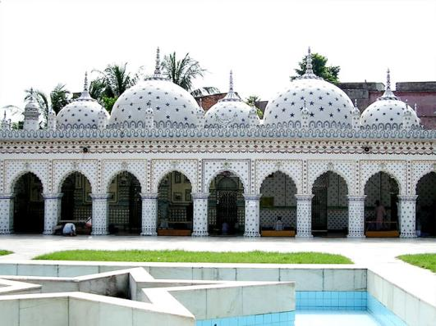
Home work
C. Look at the picture of the Star Mosque in Dhaka. Write a description on the Star Mosque with the help of the given clues. ( See the clues in the text book).
Notes:
Assignment at home.

Slide 29
Thank you so much.
Notes:
Ending slide.

